Slide 1

HR Report

Slide 2
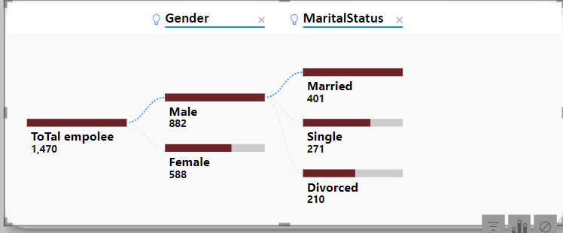
It is often observed that most people hired for HR positions, whether male or female, tend to be married. Could this pose a challenge in the hiring process
What is The majorty In company ?

Slide 3
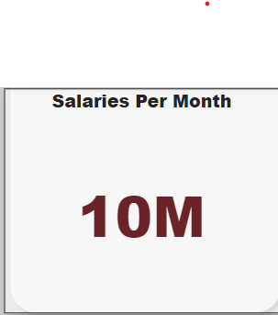
The monthly salaries of the HR department across various sections in the company amount to 10 million

Slide 4
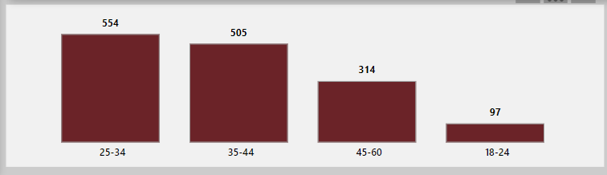
Which age group represents the highest percentage of employees in the company?
The age group 25-34 constitutes the largest number of
employees in the company.

Slide 5
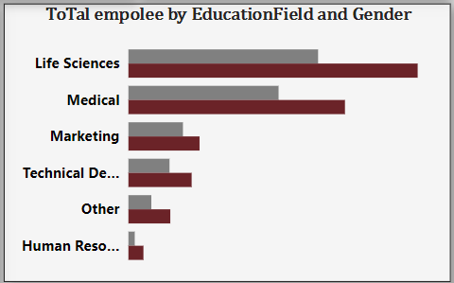
The majorty for Educationfield HR IN company?
The majority of HR professionals in the company have an educational background in life sciences and medical fields.

Slide 6
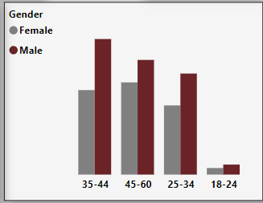
The highest income is in the age group 35-44, due to bonuses, incentives, and salary increases. However, the largest number of employees in the company belong to the 25-34 age group, but they earn lower salaries.
The Highest income ?

Slide 7
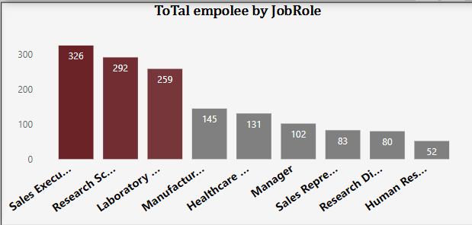
Most of the employees hired in the company are in job roles such as Sales Executive, Research Scientist, and Laboratory positions.

Slide 8
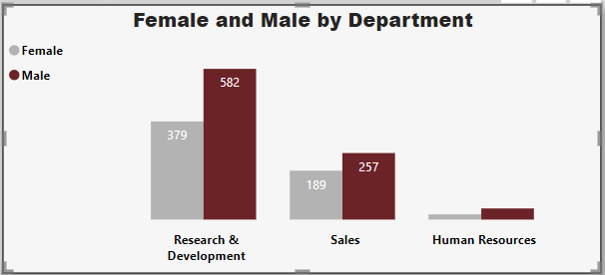
Most of the HR employees are typically in Research & Development, with fewer in Sales and Human Resources.

Slide 9
The percentage salary hike has met the expectations for HR employees. GOOD

Slide 10
Suggestions
The income of employees in the 35-44 age group is the highest Salary due to bonuses and promotions, reflecting their experience and skills. Therefore, it is essential to retain them and leverage their expertise by assigning them as instructors or mentors for newly hired employees in the 18-24 age group.
The majority of employees in first-level jobs are in the 25-34 age group. This is mainly because the company does not provide them with promotion opportunities. It is essential to address this by creating clear career advancement pathways to help them grow within the organization.

Slide 11
Suggestions
The employees in the Human Resources department show a low level of job satisfaction, which could be attributed to their relatively lower salaries. Therefore, it is important to consider increasing their salaries to ensure fairness and maintain their satisfaction
A suggestion for improvement could be to diversify the educational backgrounds of HR professionals in the company. While most have qualifications in life sciences and medical fields, it would be beneficial to also consider candidates with expertise in other areas, such as business administration or psychology, to bring a broader perspective to HR practices. This can help in enhancing the overall effectiveness and innovation within the department

Slide 12
Suggestions
Across all age groups, HR employees who live close to the company are more likely to hold HR positions. Therefore, it is preferable to hire individuals from nearby areas.
A large percentage of HR employees are in the Research & Development department, which is significantly higher compared to the other departments, such as Sales and Human Resources. Therefore, there is a need to hire more employees in both the Sales and Human Resources departments to balance the distribution across the departments

